Slide 1

CSE-221 Algorithms
Introduction to Algorithms

Slide 2
Algorithm Definition
A finite set of statements that guarantees an optimal solution in finite interval of time
Algorithmic thinking and problem solving skill are vital in making efficient solutions.
The English word "ALGORITHM" derives from the Latin word AL- AL-KHWARIZMI’S name. He developed the concept of an algorithm in Mathematics, and thus sometimes being called the “Grandfather of Computer Science".

Slide 3
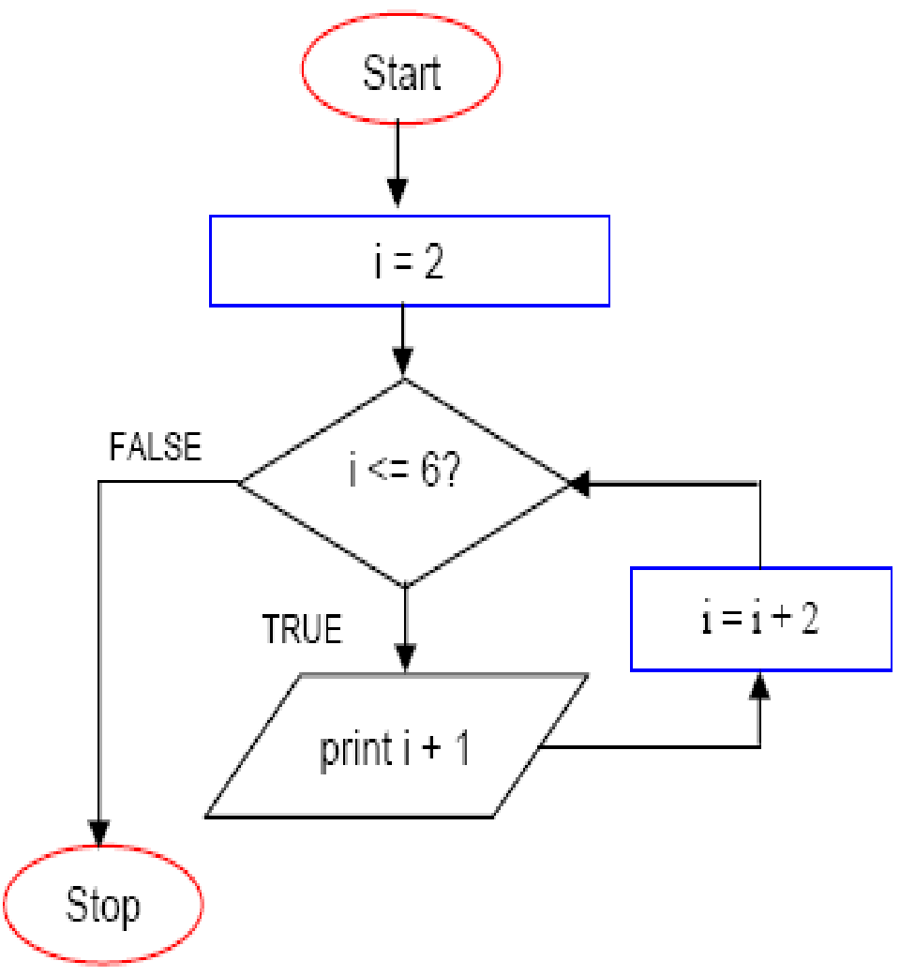
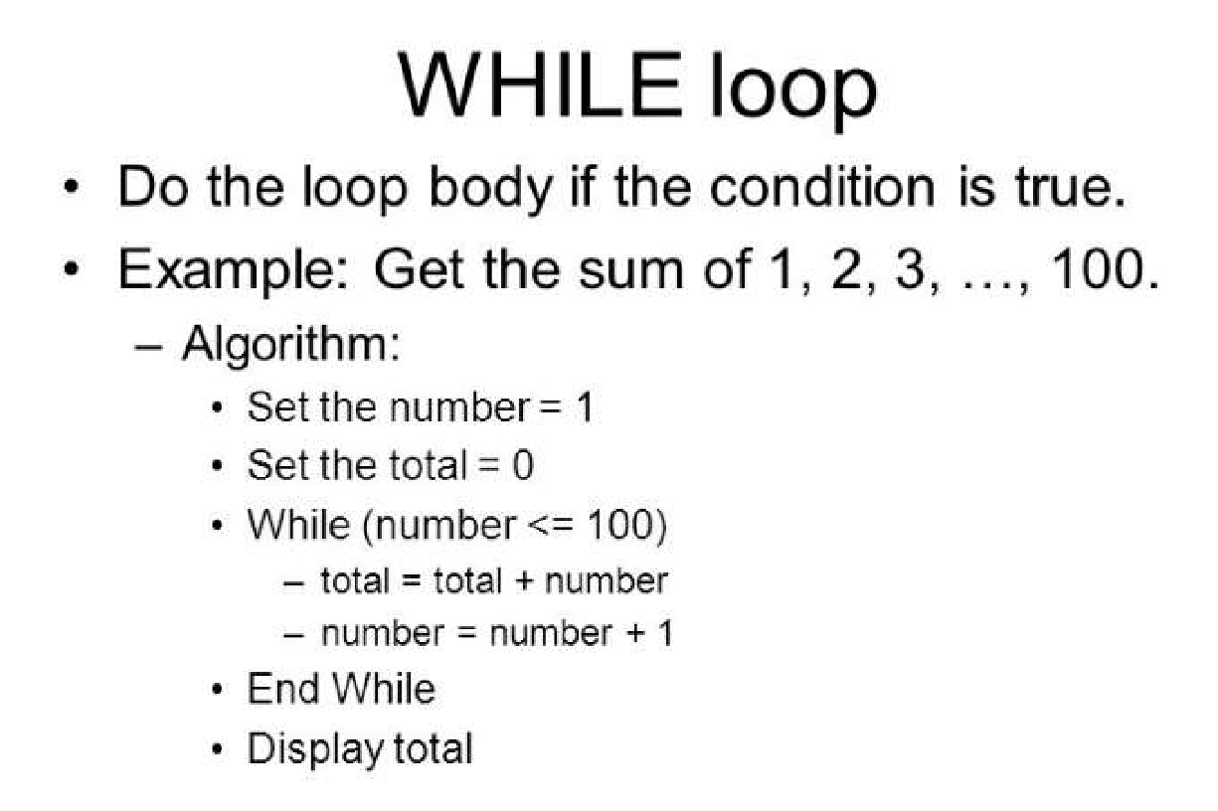
Glance of Algorithm
An algorithm is a finite set of instructions or logic, written in order, to accomplish a certain predefined task.
Algorithm is not the complete code or program
Can be expressed either as an informal high level description as pseudocode or using a flowchart.

Slide 4
Algorithm Specifications
Input - Every Algorithm must take zero or more number of input values from external.
Output - Every Algorithm must produce an output as result.
Definiteness - Every statement/instruction in an algorithm must be clear and unambiguous (only one interpretation)
Finiteness - For all different cases, the algorithm must produce result within a finite number of steps.
Effectiveness - Every Instruction must be basic enough to be carried out and it also must be feasible.

Slide 5
Good Algorithms?
Run in less time
Consume less memory
But computational resources (time complexity) usually important

Slide 6
Analyzing Algorithms
Predict the amount of resources required:
memory: how much space is needed?
computational time: how fast the algorithm runs?
FACT: running time grows with the size of the input
Input size (number of elements in the input)
Size of an array, polynomial degree, # of elements in a matrix, # of bits in the binary representation of the input, vertices and edges in a graph
Def: Running time = the number of primitive operations (steps) executed before termination
Arithmetic operations (+, -, *), data movement, control, decision making (if, while), comparison

Slide 7
Algorithm Analysis: Example
Alg.: MIN (a[1], …, a[n])
m ← a[1];
for i ← 2 to n
if a[i] < m
then m ← a[i];
Running time:
the number of primitive operations (steps) executed before termination
T(n) =1 [first step] + (n) [for loop] + (n-1) [if condition] + (n-1) [the assignment in then] = 3n - 1
Order (rate) of growth:
The leading term of the formula
Expresses the asymptotic behavior of the algorithm

Slide 8
Typical Running Time Functions
1 (constant running time):
Instructions are executed once or a few times
logN (logarithmic)
A big problem is solved by cutting the original problem in smaller sizes, by a constant fraction at each step
N (linear)
A small amount of processing is done on each input element
N logN
A problem is solved by dividing it into smaller problems, solving them independently and combining the solution

Slide 9
Typical Running Time Functions
N² (quadratic)
Typical for algorithms that process all pairs of data items (double nested loops)
N³ (cubic)
Processing of triples of data (triple nested loops)
N^{K} (polynomial)
2^{N} (exponential)
Few exponential algorithms are appropriate for practical use

Slide 10
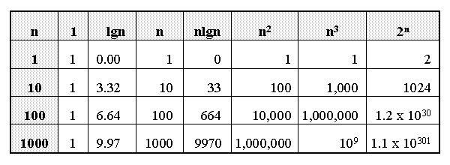
Growth of Functions

Slide 11
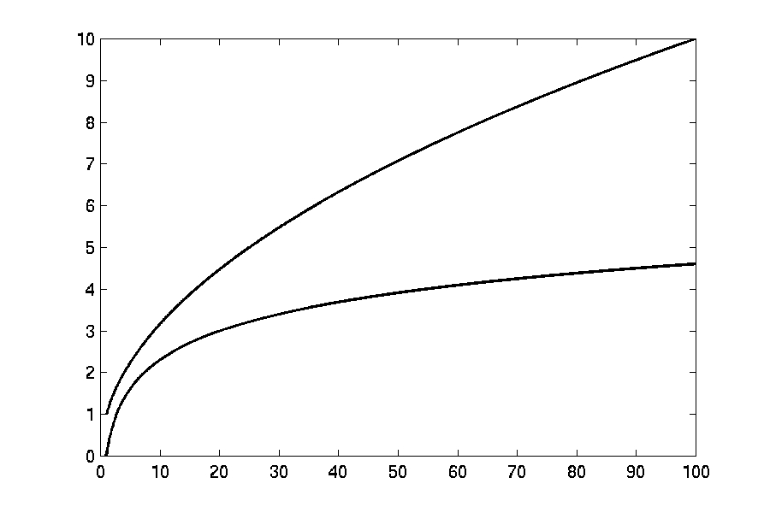

Complexity Graphs
log(n)

Slide 12
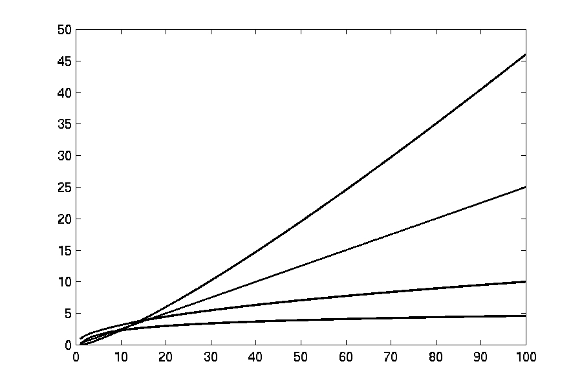

Complexity Graphs
n log(n)
n
log(n)

Slide 13
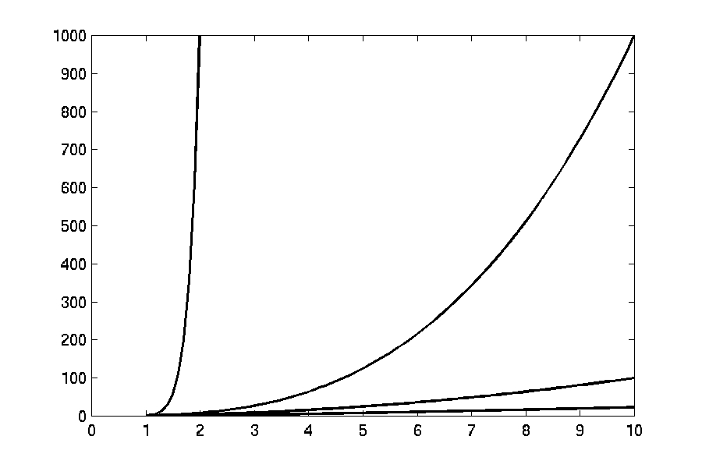
Complexity Graphs
n¹⁰
n³
n²
n log(n)

Slide 14
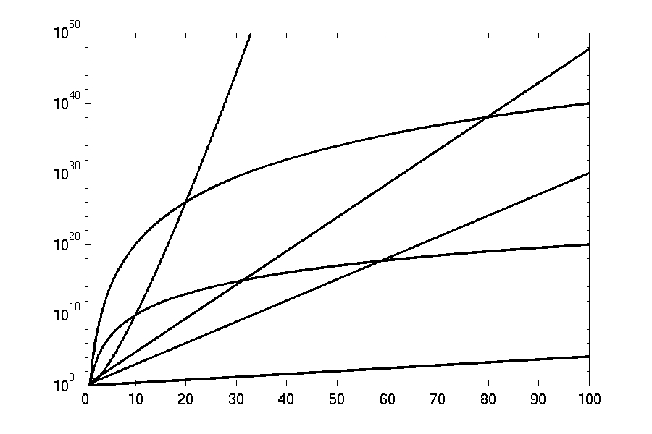
Complexity Graphs (log scale)
3^{n}
n^{n}
n²⁰
2^{n}
n¹⁰
1.1^{n}

Slide 15
Algorithm Complexity
Worst Case Complexity:
the function defined by the maximum number of steps taken on any instance of size n
Best Case Complexity:
the function defined by the minimum number of steps taken on any instance of size n
Average Case Complexity:
the function defined by the average number of steps taken on any instance of size n

Slide 16
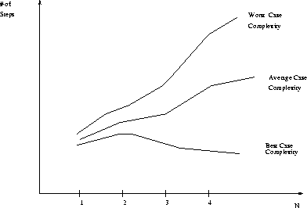
Best, Worst, and Average Case Complexity
Number of steps
Worst Case Complexity
Average Case Complexity
Best Case Complexity
N
(input size)

Slide 17
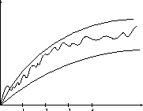
Doing the Analysis
It’s hard to estimate the running time exactly
Best case depends on the input
Average case is difficult to compute
So we usually focus on worst case analysis
Easier to compute
Usually close to the actual running time
Strategy: find a function (an equation) that, for large n, is an upper bound to the actual function (actual number of steps, memory usage, etc.)
Upper bound
Actual function
Lower bound

Slide 18
Motivation for Asymptotic Analysis
An exact computation of worst-case running time can be difficult
Function may have many terms:
4n² - 3n log n + 17.5 n - 43 n^{⅔} + 75
An exact computation of worst-case running time is unnecessary
Notes:
Random Access Machine (RAM) model. This model assumes a single processor. In the RAM model, instructions are executed one after the other, with no concurrent operations. This model of computation is an abstraction that allows us to compare algorithms on the basis of performance. The assumptions made in the RAM model to accomplish this are:
Each simple operation takes 1 time step.
Loops and subroutines are not simple operations.
Each memory access takes one time step, and there is no shortage of memory.

Slide 19
Classifying functions by their Asymptotic Growth Rates
asymptotic growth rate, asymptotic order, or order of functions
Comparing and classifying functions that ignores
constant factors and
small inputs.
The Sets big oh O(g), big theta Θ(g), big omega Ω(g)

Slide 20
Classifying functions by their Asymptotic Growth Rates
O(g(n)), Big-Oh of g of n, the Asymptotic Upper Bound
Θ(g(n)), Theta of g of n, the Asymptotic Tight Bound
Ω(g(n)), Omega of g of n, the Asymptotic Lower Bound
Notes:
asymptotically tight bound: Definition: When the asymptotic complexity of an algorithm exactly matches the theoretically proved asymptotic complexity of the corresponding problem. Informally, when an algorithm solves a problem at the theoretical minimum.

Slide 21
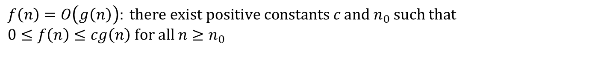
Big-O
What does it mean?
If f(n) = O(n²), then:
f(n) can be larger than n² sometimes, but…
We can choose some constant c and some value n₀ such that for every value of n larger than n₀ : f(n) < cn²
That is, for values larger than n₀, f(n) is never more than a constant multiplier greater than n²
Or, in other words, f(n) does not grow more than a constant factor faster than n².

Slide 22
Visualization of O(g(n))
cg(n)
f(n)
n₀
‹#›

Slide 23
Examples
2n² = O(n³):
n² = O(n²):
1000n²+1000n = O(n²):
n = O(n²):
2n² ≤ cn³ ⇒ 2 ≤ cn ⇒ c = 1 and n₀= 2
n² ≤ cn² ⇒ c ≥ 1 ⇒ c = 1 and n₀= 1
1000n²+1000n ≤ cn² ≤ cn²+ 1000n ⇒ c=1001 and n₀ = 1
n ≤ cn² ⇒ cn ≥ 1 ⇒ c = 1 and n₀= 1

Slide 24
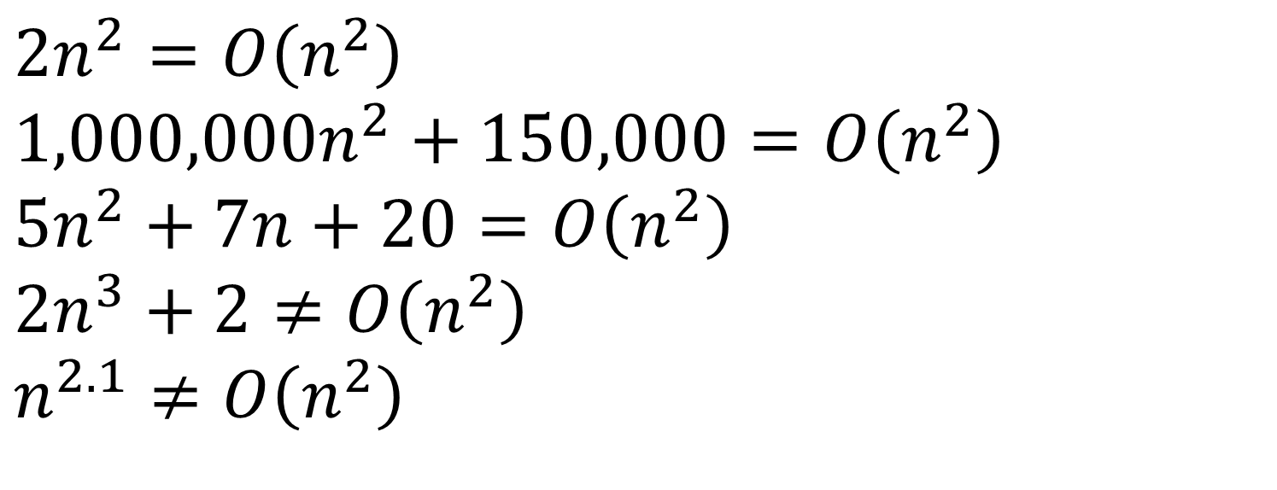
Big-O

Slide 25
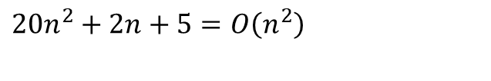
More Big-O
Prove that:
Let c = 21 and n₀ = 4
21n² > 20n² + 2n + 5 for all n > 4
n² > 2n + 5 for all n > 4
TRUE
‹#›

Slide 26
Tight bounds
We generally want the tightest bound we can find.
While it is true that n² + 7n is in O(n³), it is more interesting to say that it is in O(n²)

Slide 27
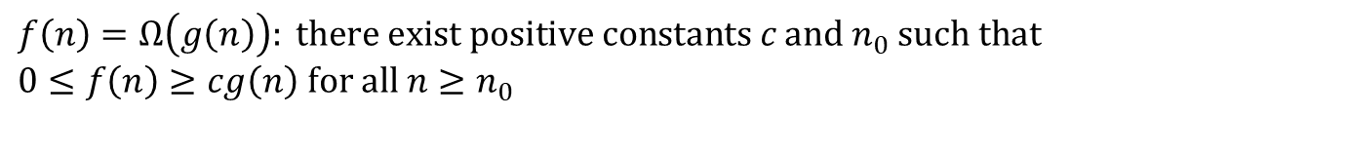
Big Omega – Notation
Ω() – A lower bound
n² = Ω(n)
Let c = 1, n₀ = 2
For all n ≥ 2, n² > 1 × n

Slide 28
Visualization of Ω(g(n))
f(n)
cg(n)
n₀

Slide 29
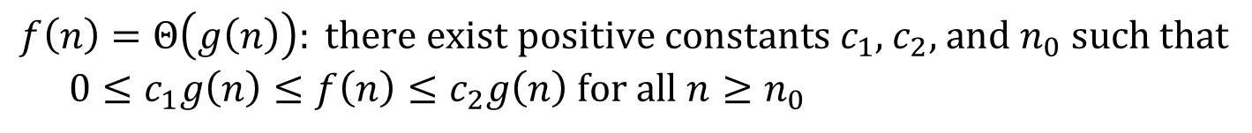
Θ-notation
Big-O is not a tight upper bound. In other words n = O(n²)
Θ provides a tight bound
In other words,

Slide 30
Visualization of Θ(g(n))
c₂g(n)
f(n)
c₁g(n)
n₀
‹#›

Slide 31
A Few More Examples
n = O(n²) ≠ Θ(n²)
200n² = O(n²) = Θ(n²)
n^{2.5} ≠ O(n²) ≠ Θ(n²)

Slide 32
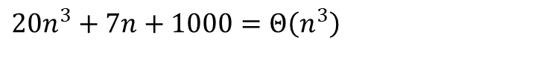
Example 2
Prove that:
Let c = 21 and n₀ = 10
21n³ > 20n³ + 7n + 1000 for all n > 10
n³ > 7n + 5 for all n > 10
TRUE, but we also need…
Let c = 20 and n₀ = 1
20n³ < 20n³ + 7n + 1000 for all n ≥ 1
TRUE

Slide 33

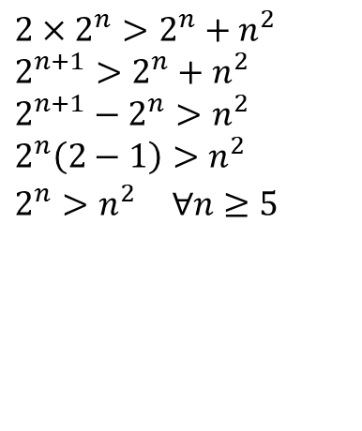
Example 3
Show that
Let c = 2 and n₀ = 5
✔

Slide 34
Asymptotic Notations - Examples
Θ notation
n²/2 – n/2
(6n³ + 1)lgn/(n + 1)
n vs. n²
Ω notation
n³ vs. n²
n vs. logn
n vs. n²
= Θ(n²)
= Θ(n²lgn)
n ≠ Θ(n²)
O notation
2n² vs. n³
n² vs. n²
n³ vs. nlogn
n³ = Ω(n²)
2n² = O(n³)
n = Ω(logn)
n² = O(n²)
n ≠ Ω(n²)
n³ ≠ O(nlgn)

Slide 35
Asymptotic Notations - Examples
For each of the following pairs of functions, either f(n) is O(g(n)), f(n) is Ω(g(n)), or f(n) = Θ(g(n)). Determine which relationship is correct.
f(n) = log n²; g(n) = log n + 5
f(n) = n; g(n) = log n²
f(n) = log log n; g(n) = log n
f(n) = n; g(n) = log² n
f(n) = n log n + n; g(n) = log n
f(n) = 10; g(n) = log 10
f(n) = 2^{n}; g(n) = 10n²
f(n) = 2^{n}; g(n) = 3^{n}
f(n) = Θ (g(n))
f(n) = Ω(g(n))
f(n) = O(g(n))
f(n) = Ω(g(n))
f(n) = Ω(g(n))
f(n) = Θ(g(n))
f(n) = Ω(g(n))
f(n) = O(g(n))

Slide 36
Simplifying Assumptions
1. If f(n) = O(g(n)) and g(n) = O(h(n)), then f(n) = O(h(n))
2. If f(n) = O(kg(n)) for any k > 0, then f(n) = O(g(n))
3. If f₁(n) = O(g₁(n)) and f₂(n) = O(g₂(n)),
then f₁(n) + f₂(n) = O(max (g₁(n), g₂(n)))
4. If f₁(n) = O(g₁(n)) and f₂(n) = O(g₂(n)),
then f₁(n) * f₂(n) = O(g₁(n) * g₂(n))

Slide 37
Some Simplified Rules
O(1) = c , where c is a constant
O(n) = c*n = cn , where c is constant and n is variable
c₁*O(1) = c₁*c = c₂ = O(1) , where c,c₁,c₂ are constants
O(1) + O(1) + O(1) = 3*O(1) = O(1)
5*O(1) = O(1)
n*O(1) = n*c = cn = O(n) , where c is constant and n is variable
O(m) + O(n) ≠ O(m+n)
O(m) * O(n) = c₁mc₂n = (c₁*c₂)(mn) = (c₂)(mn) = O(mn)
O(m)*O(n)*O(p)*O(q) = O(m(n(p(q)))) = O(mnpq)
Example nested for loops
O(an² + bn + c) = O(n²) where a, b , c are constants

Slide 38
Example #1: carry n books from one bookshelf to another one
How many operations?
n pick-ups, n forward moves, n drops and n reverse moves 🡪 4 n operations
4n operations = c. n = O(c. n) = O(n)
Similarly, any program that reads n inputs from the user will have minimum time complexity O(n).

Slide 39
Example #2: Locating Roll-Number record in Attendance Sheet
What is the time complexity of search?
Binary Search algorithm at work
O(log n)
Sequential search?
O(n)

Slide 40
Example #3: Teacher of CSE 221 gives gifts to first 10 students
There are n students in the queue.
Teacher brings one gift at a time.
Time complexity = O(c. 10) = O(1)
Teacher will take exactly same time irrespective of the line length.

Slide 41
Loops with Break
for (j = 0; j < n; ++j) {
// 3 atomics
if (condition) break;
}
Upper bound = O(4n) = O(n)
Lower bound = Ω(4) = Ω(1)
Complexity = O(n)
Ques: Why don’t we have a Θ(…) notation here?

Slide 42
Sequential Search
Given an unsorted vector/list a[ ], find the location of element X.
for (i = 0; i < n; i++) {
if (a[i] == X) return true;
}
return false;
Input size: n = array size()
Complexity = O(n)

Slide 43
If-then-else Statement
if(condition)
i = 0;
else
for ( j = 0; j < n; j++)
a[j] = j;
Complexity = ??
= O(1) + max ( O(1), O(N))
= O(1) + O(N)
= O(N)

Slide 44
Consecutive Statements
Add the complexity of consecutive statements
Complexity = O(3n + 5n) = O(n)
for (j = 0; j < n; ++j) {
// 3 atomics
}
for (j = 0; j < n; ++j) {
// 5 atomics
}

Slide 45
Nested Loop Statements
Analyze such statements inside out
for (j = 0; j < n; ++j) {
// 2 atomics
for (k = 0; k < n; ++k) {
// 3 atomics
}
}
Complexity = O((2 + 3n)n) = O(n²)

Slide 46
Example
Code:
a = b;
Complexity:
Notes:
constant

Slide 47
Example
Code:
sum = 0;
for (i=1; i <=n; i++)
sum += n;
Complexity:
Notes:
linear

Slide 48
Example
Code:
sum = 0;
for (j=1; j<=n; j++)
for (i=1; i<=j; i++)
sum++;
for (k=0; k<n; k++)
A[k] = k;
Complexity:
Notes:
N squared == 1 + 2 + … + N

Slide 49
Example
Code:
sum1 = 0;
for (i=1; i<=n; i++)
for (j=1; j<=n; j++)
sum1++;
Complexity:
Notes:
Obviousy n squared

Slide 50
Example
Code:
sum2 = 0;
for (i=1; i<=n; i++)
for (j=1; j<=i; j++)
sum2++;
Complexity:

Slide 51
Example
Code:
sum1 = 0;
for (k=1; k<=n; k*=2)
for (j=1; j<=n; j++)
sum1++;
Complexity:
Notes:
outer loop O(lg N), inner loop (N) == O (N lg N) by product rule

Slide 52
Example
Code:
sum2 = 0;
for (k=1; k<=n; k*=2)
for (j=1; j<=k; j++)
sum2++;
Complexity:
Notes:
outer O (lg N) inner = sum of powers of 2 which is linear since
The sum of powers of 2 dividing into N is 2N so its O (N lg N) by product rule

Slide 53
Recursion
long factorial( int n )
{
if( n <= 1 )
return 1;
else
return n*factorial(n- 1);
}
In terms of big-Oh:
t(1) = 1
t(n) = 1 + t(n-1) = 1 + 1 + t(n-2)
= ... k + t(n-k)
Choose k = n-1
t(n) = n-1 + t(1) = n-1 + 1 = O(n)
Consider the following time complexity:
t(0) = 1
t(n) = 1 + 2t(n-1) = 1 + 2(1 + 2t(n-2)) = 1 + 2 + 4t(n-2)
= 1 + 2 + 4(1 + 2t(n-3)) = 1 + 2 + 4 + 8t(n-3)
= 1 + 2 + ... + 2^{k-1} + 2^{k}t(n-k)
Choose k = n
t(n) - 1 + 2 + ... 2^{n-1} + 2^{n} = 2^{n+1} - 1

Slide 54
Binary Search
Given a sorted vector/list a[ ], find the location of element X
unsigned int binary_search(vector<int> a, int X)
{
unsigned int low = 0, high = a.size()-1;
while (low <= high) {
int mid = (low + high) / 2;
if (a[mid] < X)
low = mid + 1;
else if( a[mid] > X )
high = mid - 1;
else
return mid;
}
return NOT_FOUND;
}
Input size: n = array size()
Complexity = O( k iterations x (1 comparison+1 assignment) per loop)
= O(log(n))

Slide 55
Summary
Time complexity is a measure of algorithm efficiency
Efficient algorithm plays the major role in determining the running time.
Q: Is it possible to determine running time based on algorithm’s time complexity alone?
Minor tweaks in the code can cut down the running time by a factor too.
Other items like CPU speed, memory speed, device I/O speed can help as well.
For certain problems, it is possible to allocate additional space & improve time complexity.

Slide 56
Summary
Time complexity is a measure of algorithm efficiency
Efficient algorithm plays the major role in determining the running time.
Q: Is it possible to determine running time based on algorithm’s time complexity alone?
Minor tweaks in the code can cut down the running time by a factor too.
Other items like CPU speed, memory speed, device I/O speed can help as well.
For certain problems, it is possible to allocate additional space & improve time complexity.

